Slide 1
FudgeMart Inc. Data Warehouse & BI Solution
By: Alex Hyman, Amanda Carvalho, Brett Jungles, and Cindy Khuu
IST 722 Data Warehouse

Slide 2
Goal for Project
Create a data warehouse
Build a business intelligence platform
Business users can easily access:
Operational data
Financial data
Supply chain data
Help FudgeMart Inc make better data-driven decisions

Slide 3
Business Processes (Simple)
FudgeMart Customer Reviews (Simple)
FudgeMart offers a system in which FudgeMart customers can review FudgeMart products
Product reviews help us track the the quality of products over time
Transaction
FudgeFlix Movie Views (Simple)
FudgeFlix tracks which movies are viewed by each customers, and the review that the customer has given the movie
Tracking which movies have been viewed by each customer will allow us to recommend movies to the customers to better enhance their experience
Transaction

Slide 4
Business Processes (Complex)
FudgeMart Inc. Total Sales
FudgeMart sells products to customers in an online store
FudgeFlix has customers subscribed to a monthly payment plan
Tracking the total sales for the company allows us to track the growth of company
Transaction
FudgeMart Inc. Order Fulfillment
FudgeMart ships their products to customers after ordering online
FudgeFlix ships certain movies to customers similar to the old NetFlix business model
Tracking the shipping process from order to delivery in both delivered movies and shipped products could help reduce the wait time for customers and improve their experience
Accumulating Snapshot

Slide 5
Functional Requirements
FudgeMart Customer Product Reviews
Business users must be able to analyze the reviews of FudgeMart products over time and by the customer
FudgeFlix Movie Viewings
Business must be able to analyze the the movies FudgeFlix customers have watched over time and see what rating the customer had given the movie
Total Sales
Business users must be able to analyze every payment FudgeMart Inc. has received over time and by subsidiary, product, customer, and region
Order Fulfillment
Business users must be able to analyze the progress of movies or products shipments and have the number days between ordered and shipped determine be able to filter by day of the week ordered, product department, and region the movie or product was shipped to

Slide 6
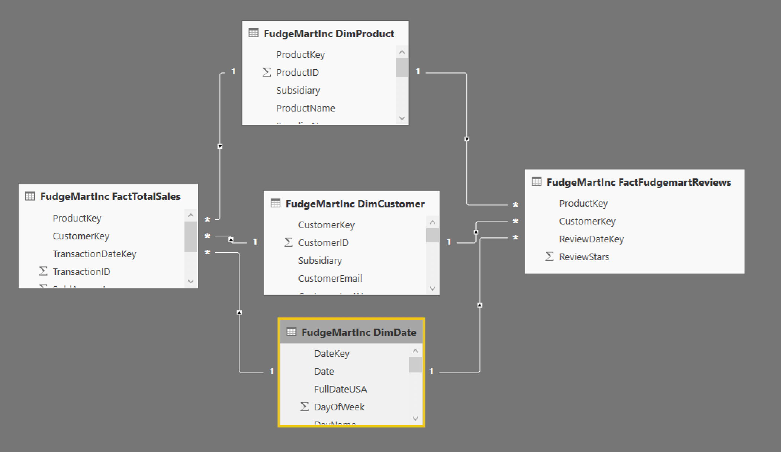
Star Schema Diagram

Slide 7
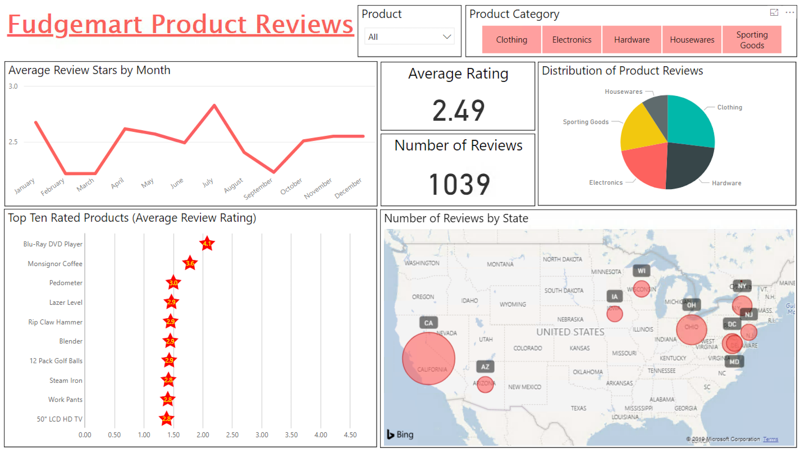

Slide 8

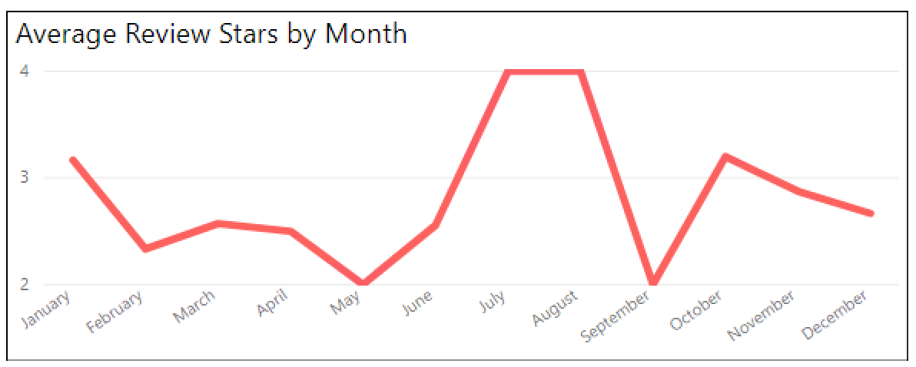
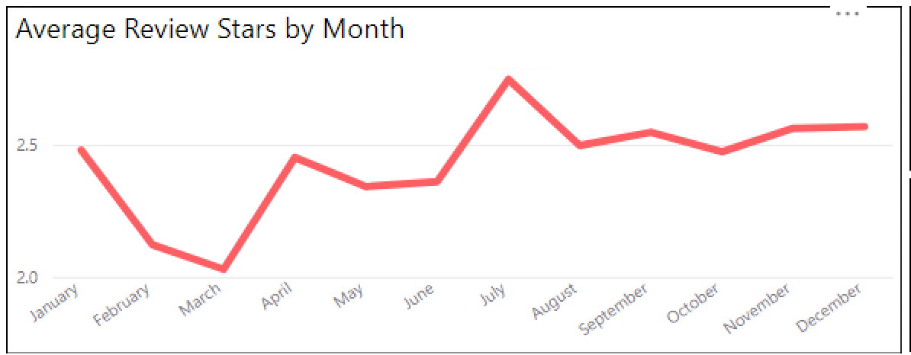
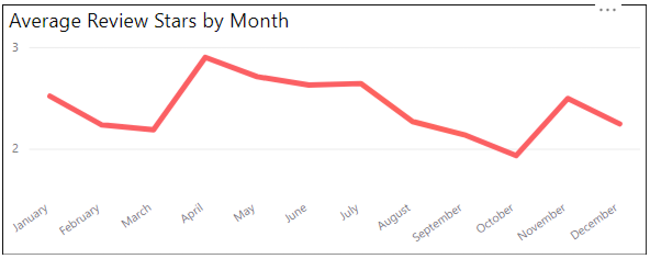
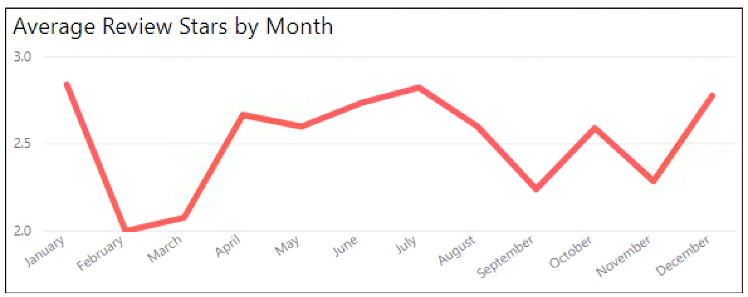
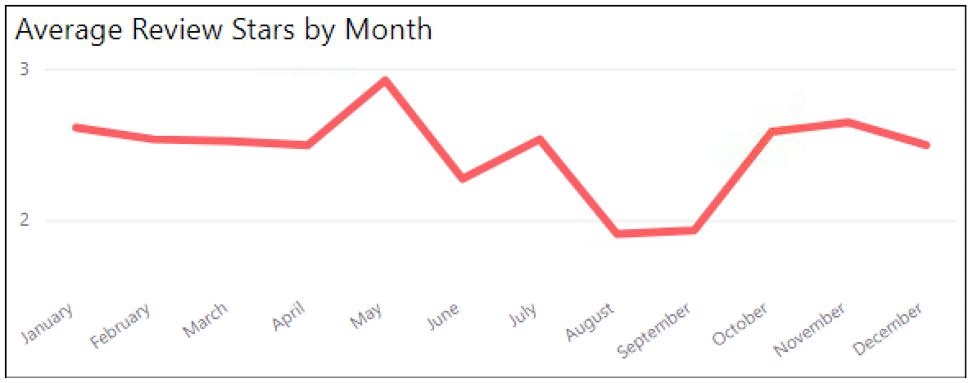
Housewares
Clothing
Hardware
Electronics
Sporting Goods

Slide 9
Recommendation to improve Fudgemart Product Reviews
Focus on increasing number of customer product reviews collected to provide larger sample size and interactions
Achieve by reminding customers to review a product or incentivizing them
Make customer review process easier for them by one click from email
Focus on deep diving electronics to understand what’s driving large fluctuations in ratings, which can help improve overall company score with it making up largest units sold

Slide 10
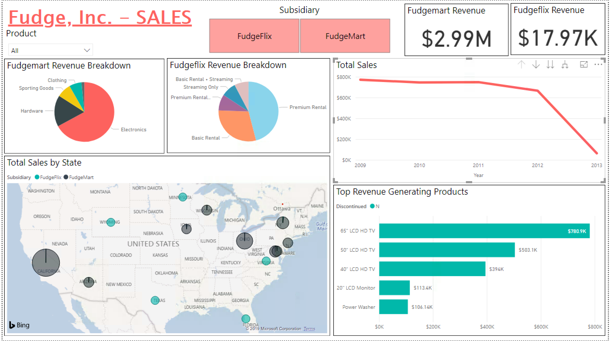
Notes:
LTD Fudgemart makes up a larger portion of the total Fudgemart Inc revenue with $3M compared to Fudgeflix at $18K

Slide 11
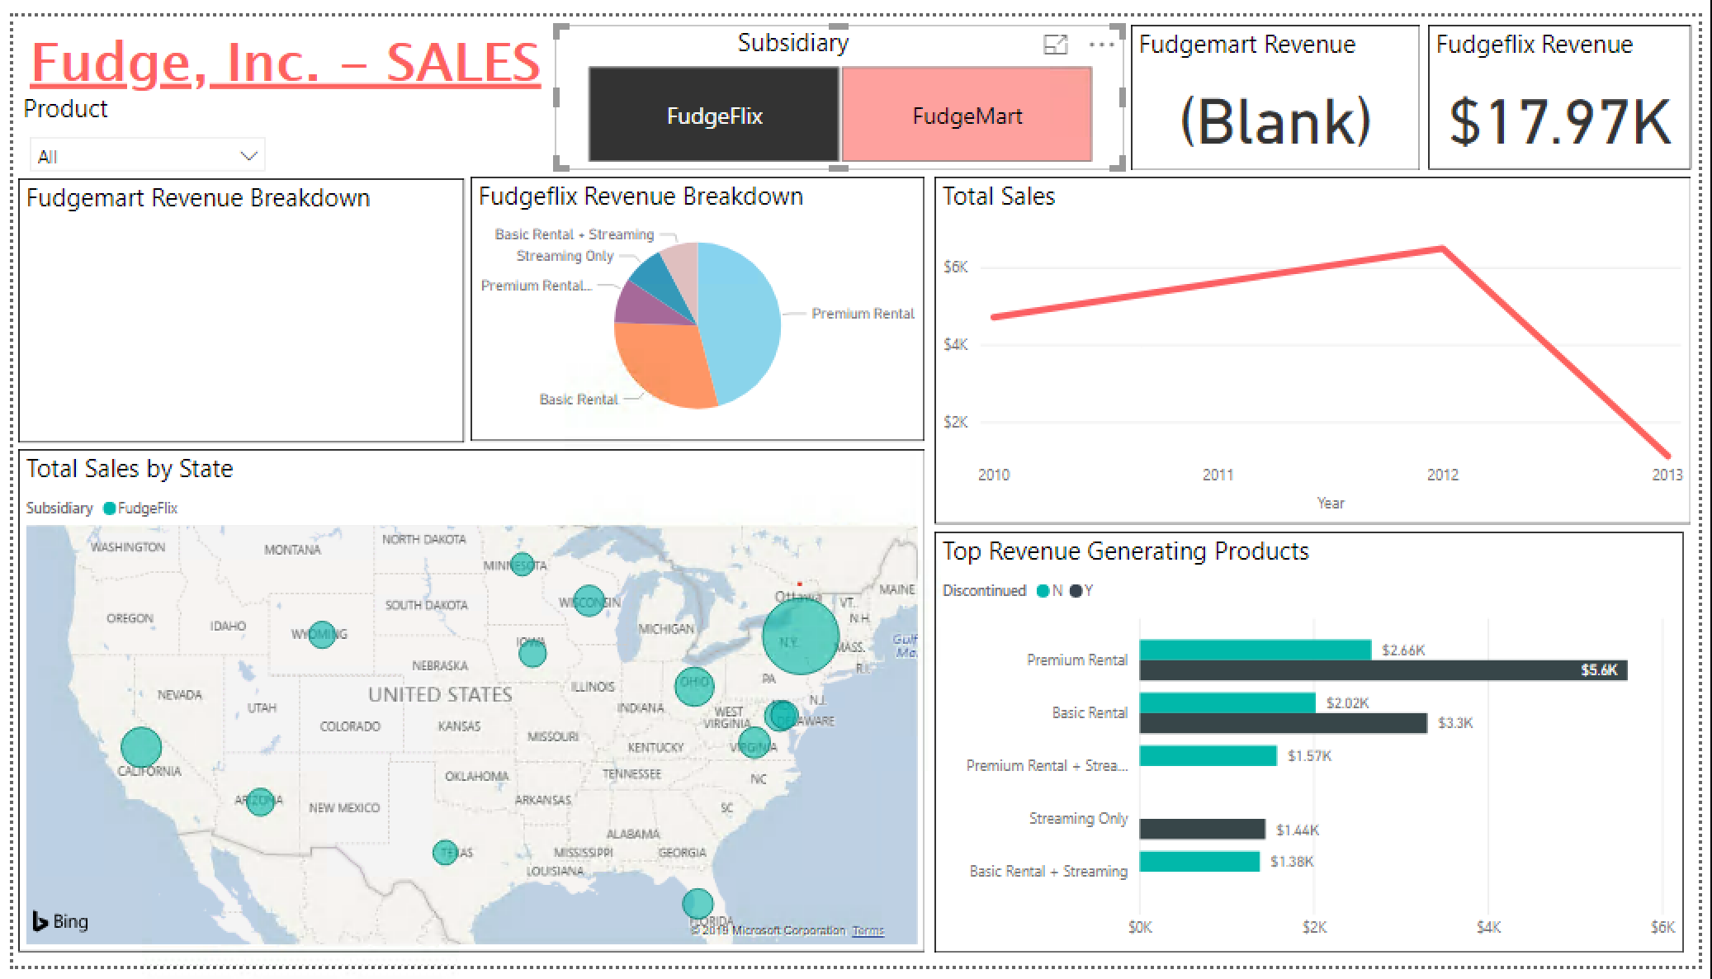
Notes:
Looking at year to year comparison to 2012, there’s been growth. Focusing on what’s driving the growth in 2012….

Slide 12
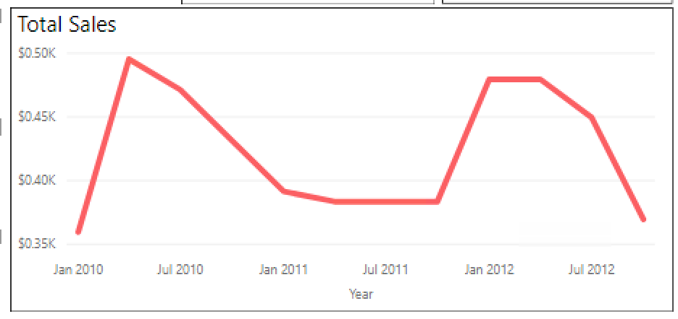
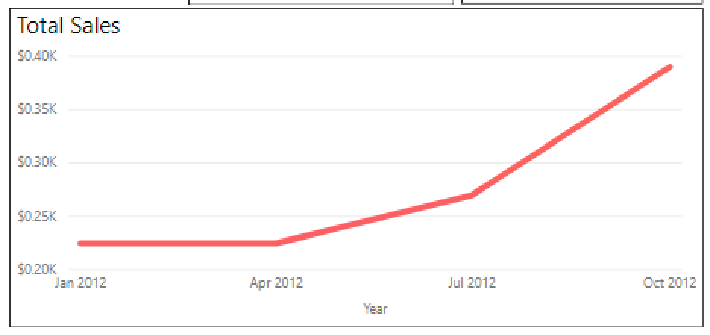
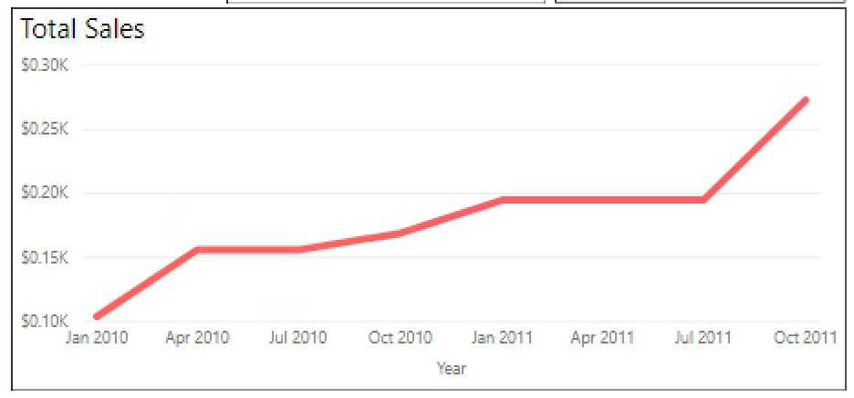
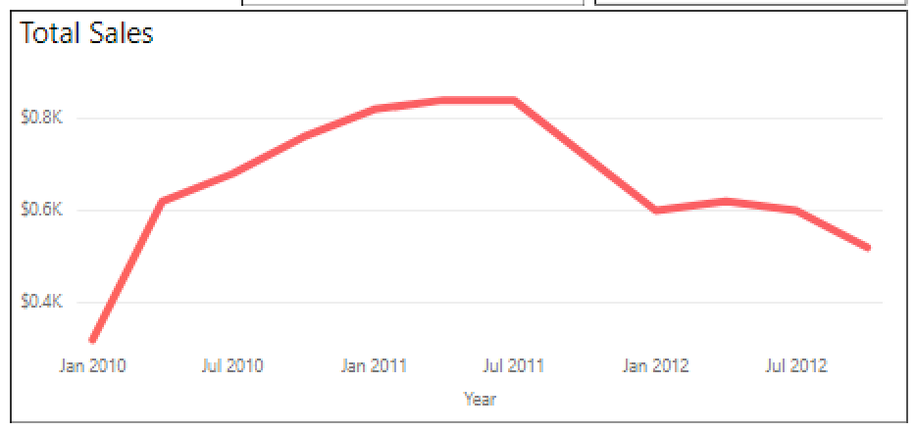
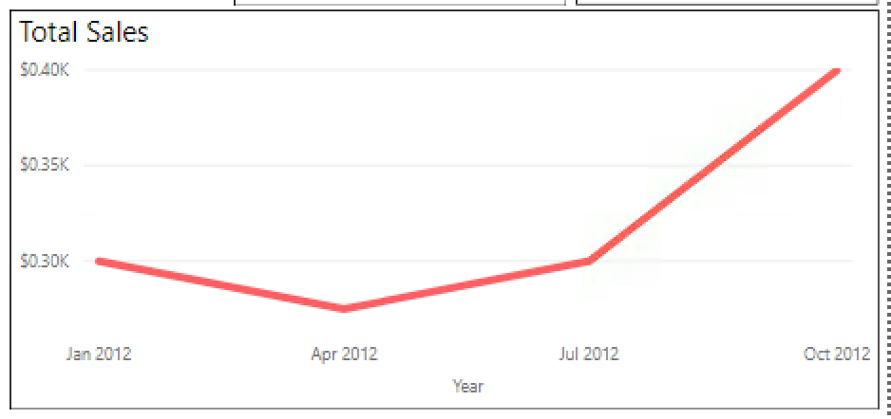
Fudgemart Inc SALES - Fudgeflix
Basic Rental
Mixed
Basic Rental + Streaming
(Growth)
Streaming Only
(Growth)
Premium Rental
(Decline)
Premium Rental + Streaming
(Growth)

Slide 13
Recommendation for Fudgeflix’s Sales
Offer customers a free trial period for bundle plans, which have higher pricing
Customers will experience convenience of streaming and video by mail
Able to generate more revenue with more customers in higher priced bundle plans

Slide 14
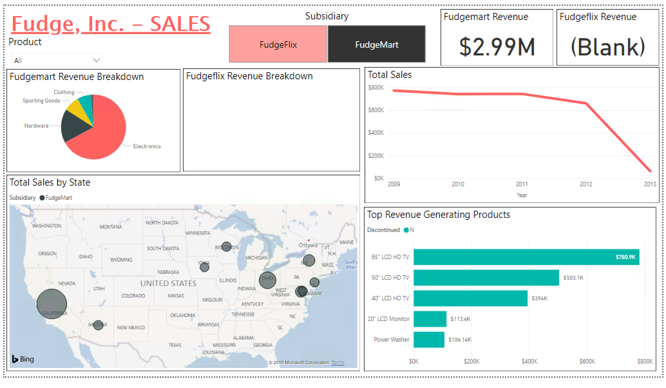

Slide 15
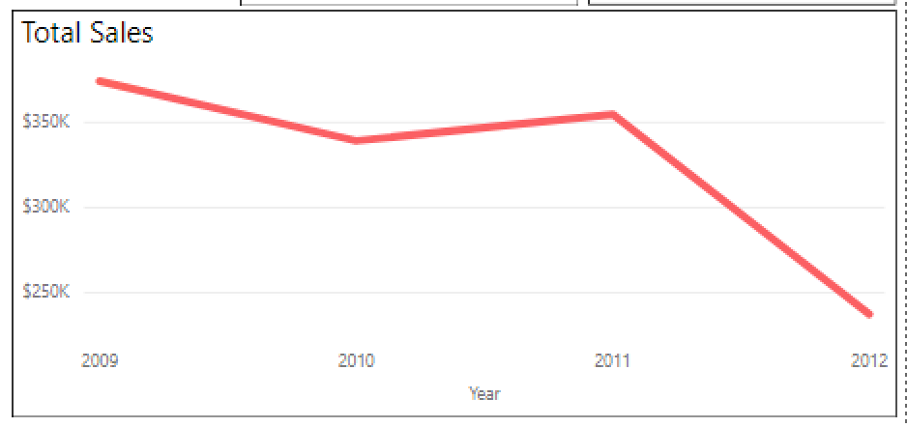
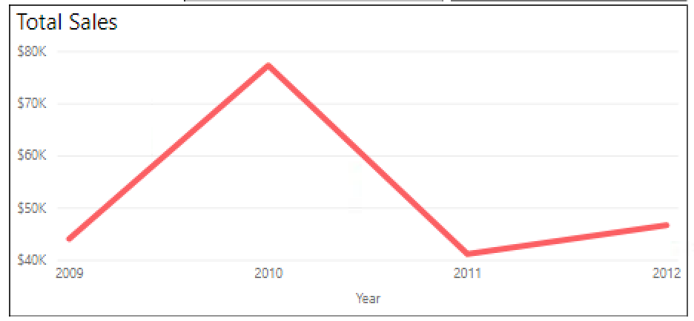
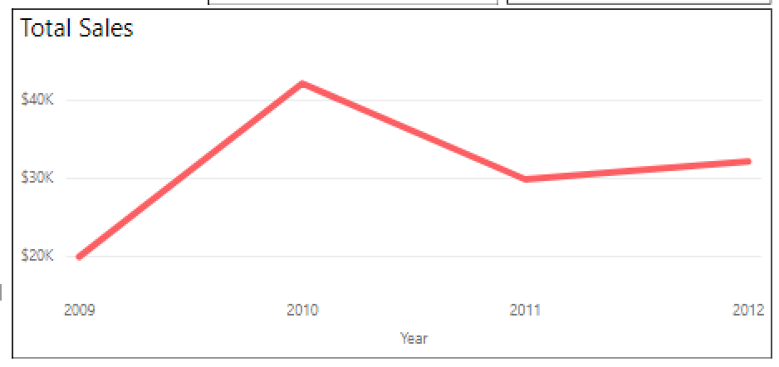
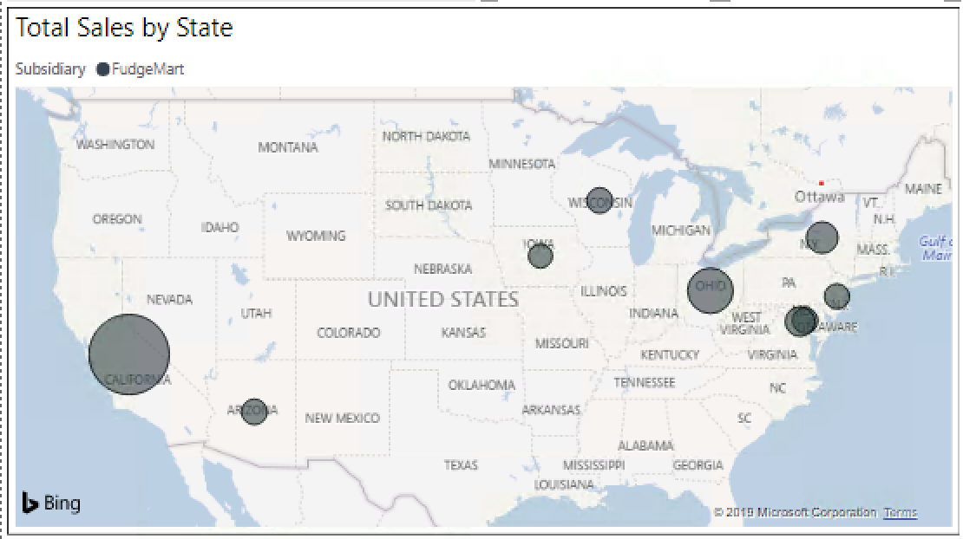
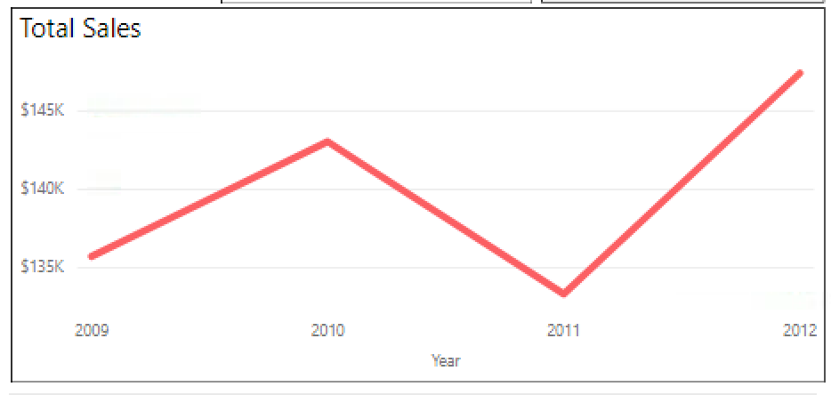
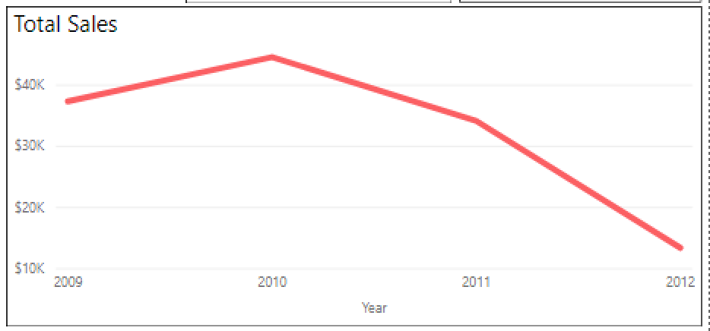
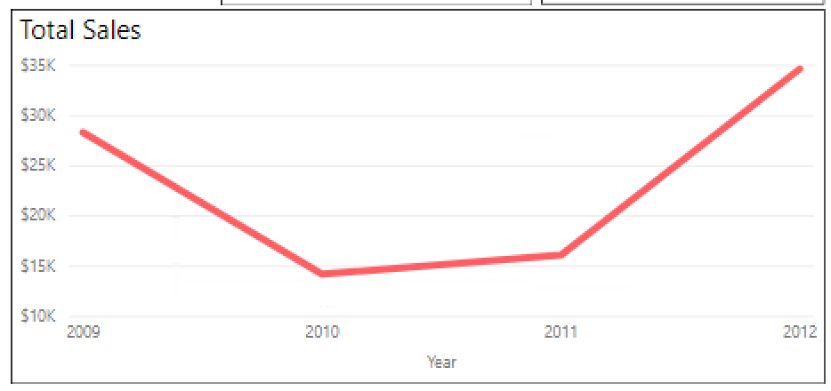
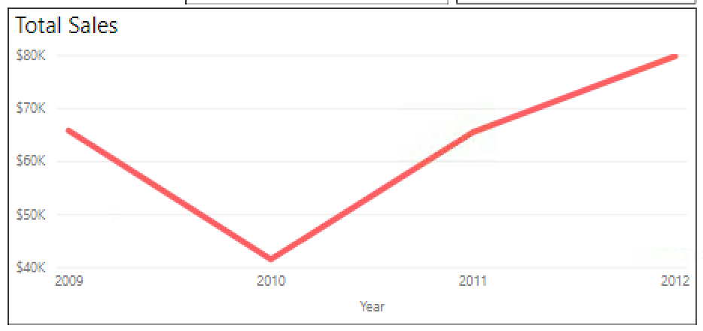
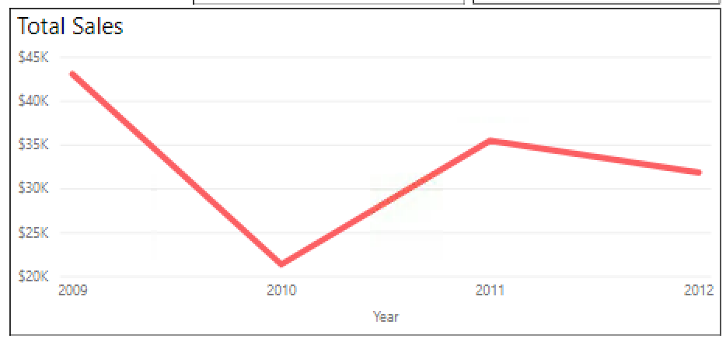

Fudgemart Inc SALES - Fudgemart
Ordered based on Total Sales $ by State
1. CA (Decline)
4. DC (Growth)
7. MD (Growth)
2. OH (Growth)
5. AZ (Decline)
8. NJ (Growth)
3. NY (Growth)
6. WI (Decline)
9. IA (Growth)

Slide 16
Recommendation for Fudgemart’s Sales
Perform market analysis in California to understand factors contributing to sales decline (ex: new competition, issues with assortment for local customers)
Potentially implement retention program or email campaign as a solution

Slide 17
Power BI
https://app.powerbi.com/groups/me/reports/fbca6a26-169b-4b26-bd9f-0544f103c202?ctid=4278a402-1a9e-4eb9-8414-ffb55a5fcf1e

